Slide 1
Introducing Design Thinking in Primary Schools
14/04/2021

Slide 2
Hello!
Welcome to D-TIPS.
D-TIPS stands for Design Thinking in Primary Schools.
The aim of this project is to bring the innovative, creative and collaborative process of design thinking into primary schools. We believe design thinking can equip children with many valuable skills for the future.
During this presentation we will explore how the design thinking process can enrich learning, each of the phases of the process and the toolbox for embarking on your first design challenge!

Slide 3
INSPIRATION
Before you embark on your first design challenge using the D-TIPS toolbox, we first wanted to show why design thinking is such a valuable approach to creative problem solving.
Over the next few slides we will introduce what is design thinking, and why is it a valuable learning tool.

Slide 4
What is design thinking?
A different way of thinking
Design Thinking is not just a method, but also a mindset for creative problem-solving.
So what is a mindset? A mindset is defined as the ideas and attitudes with which a person approaches any given situation. This way we can adopt different mindsets to help us look at problems different ways.
Design thinking can be viewed as a mindset in itself. It is a mindset that views failure as a positive and valuable learning tool and it values the possibilities that come with "not-knowing". The design thinking mindset sees uncertainty as normal and ok, creativity as essential and reflection is essential to any learning experience.
Design Thinking can be used anywhere, but has the potential to play a significant role in education. It can be used to find creative solutions to problems, but also to develop a mindset that turns all experiences into learning experiences. The D-TIPS toolbox is specifically tailored to the needs of primary school teachers to assist them in testing and adopting a design thinking mindset that benefits them, and in turn, benefits their students.
Iteration
Embracing Uncertainty
Learning from Failure
Design Thinking Mindsets
Empathy
Creative confidence

Slide 5
Introduction to design thinking - Click on the link to see the video (for Romanian subtitles select in the video settings. )

Slide 6
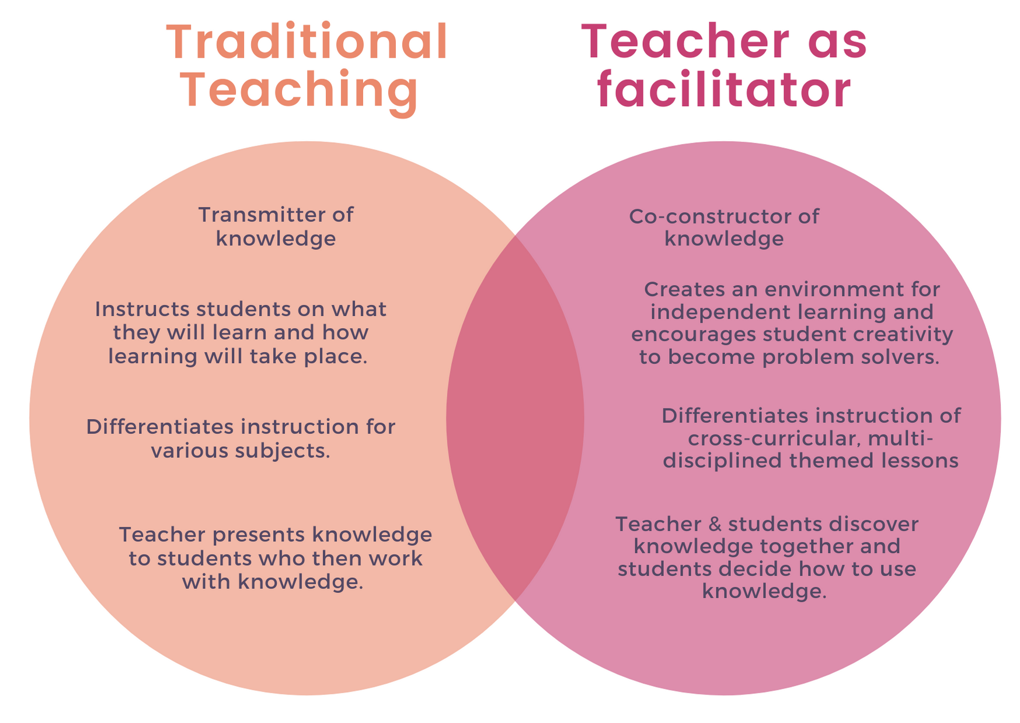
How will it benefit you?
The teacher as facilitator.
The D-TIPS toolbox uses the design thinking process to help shift the traditional role of the teacher to that of a facilitator.
In the facilitator role, the teacher is no longer the holder of knowledge that students have to go to to gain new understanding and to progress their learning. Instead the teacher operates as a guide that supports students as they explore and solve problems.
By shifting the focus away from the teacher to a student-centred approach, students can then have more agency and ownership of their own learning.
While this approach may seem a bit challenging at first, by letting go of the teaching role, it can actually be a liberating experience for teachers. When facilitating rather than teaching you share the decision making and design responsibility with the students, while offering your expertise as a guide to help your students achieve their goals.
This approach frees up space for teachers to focus on nurturing, inspiring and connecting with their students as they learn and foster an atmosphere where everyone is exploring and learning, including the teacher.

Slide 7
Learning from Failure
Creating space for failure is as important for teachers as it is for students.

Slide 8
How can it help your school?
Applied learning.
Professional Development can sometimes seem like a chore, especially when we feel as though there is little focus on developing our creative and innovative potential. Often teachers are fed new approaches, new tools, new research, but without a clear pathway for how to integrate them into their practice.
But what makes design thinking unique as an approach, is that the learning and growing happens as part of the process of doing it. We call this action-learning.
What D-TIPS offers to teachers is the tools, structure and support they need to dive into real-world design challenges that can directly make a positive impact on their school, colleagues, kids, communities and the environment.
D-TIPS brings action-learning to the forefront of both personal and professional development that sees the learning needs of teachers as much as their students. And, in doing so, equips teachers with the mindsets and tools to make lasting impact in their communities.
Curriculum
Redesign learning experiences that tap into the real interests of your students and connect them to existing challenges in their community.
Spaces
Redesign your classroom, or any other space or environment in your school. Help your school to maximise its potential for creativity, community and sustainability.
Processes & Tools
Use design thinking to rethink how processes are done and how they impact the wellbeing of staff and students as well as the effectiveness of the school, and design tools that can support these processes better.

Slide 9
Multifunctional
With the D-TIPS toolkit, design thinking can be used to working cross-curricular or to solve real problems within your community.

Slide 10
How will it benefit your students?
Ownership over learning.
In its essence, design thinking is a learning process. It is a process that draws on the users ability to empathise with others, explore possibilities, experiment and reflect, as a means of solving problems where no-one knows the answer.
By engaging with this process, the student is able to use their curiosity and creativity to explore problems within a guided framework. By allowing space for freedom to make decisions and experiment, students get to discover and reflect on what they are good at and how they can collaborate with others.
Through this combination of implicit and explicit learning, students can discover their strengths and build creative confidence that helps them to develop a stronger sense of self and take ownership of their learning journey.
Problem solving
Creativity
Collaboration
Critical thinking
Reflection & Self-awareness
Real-world effectiveness
Adaptability & resilience
Skills for
lifelong learning
Taking initiative

Slide 11
21st Century skills
Envisioning the future and designing learning that prepares students for complexity and uncertainty.

Slide 12
THE D-TIPS TOOLBOX
So now that you have a better idea of why design thinking is valuable, here we can take you through each of the phases of the design thinking process and the tools.
Over the next few slides we will explain each of the design thinking steps and how to approach each phase, then we will introduce you to the tools you will use during each of these phases.

Slide 13
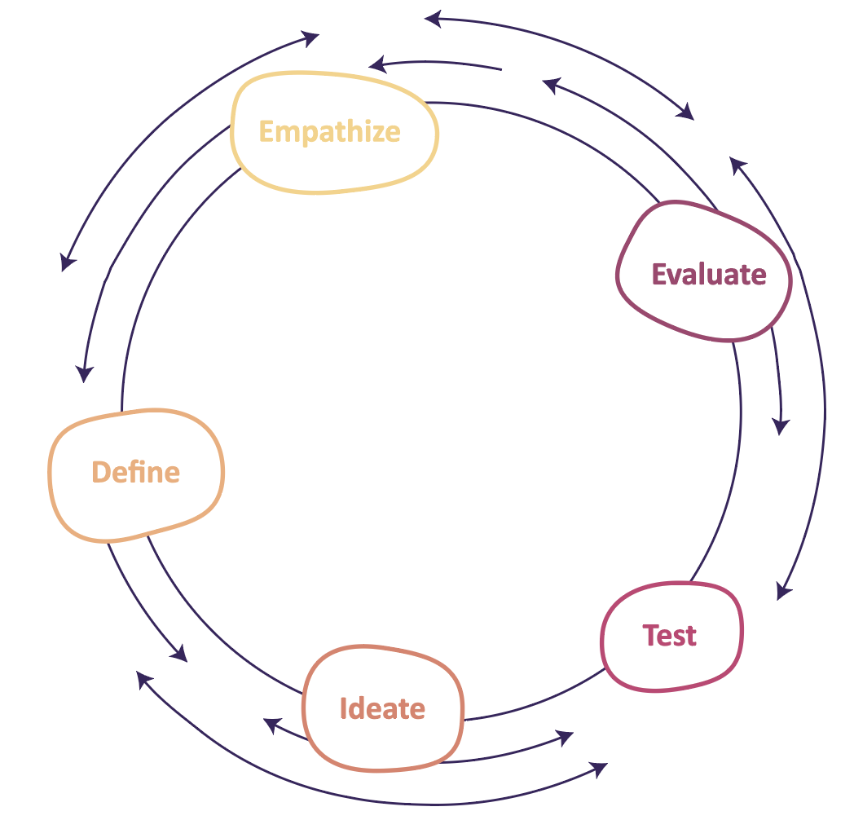
Design thinking Phase 1
Empathy
The first step when embarking on a design challenge is to first take the time to understand who you are designing for. Empathising is crucial to the design thinking process because it helps us to walk in the shoes of another and uncover new information that we can use to build better solutions.
Empathy is a powerful tool, not only to understand the experience of others, but to uncover what their needs are. When you take the time to actively listen, observe, ask questions and immerse yourself in the experience of those around you, you will often encounter surprising information that can radically change your perception and assumptions of how things “are”.
In this phase it is important to refrain from jumping to solutions, but rather slow-down and use observation, listening and curiosity to uncover new information.

Slide 14
Design thinking Phase 2
Define
Once you have gathered as much information as you can during the emphasise phase, you can then unpack your findings, reflect on your insights and begin to frame a meaningful design challenge. While you might think you already have the solution, it’s important to first examine and reflect on what you have collected. You might be surprised by what you find, and it is this information that could determine the quality of the potential solution.
The define phase requires a critical thinking and reflective mindset that reviews the data collected and starts to identify connections between information as well as what we found to be the most unexpected discoveries. By reflecting on this information we can start to formulate a clear problem to solve.

Slide 15
Design thinking Phase 3
Ideate
Now that you have dedicated a good amount of research and reflection in the empathy and define phase, you can finally shift from defining the problem to exploring the solutions.
In this phase you shift into a “what-if” mindset, where you are using creativity and imagination to explore all possible solutions. With all the information you have gathered you generate informed ideas.
In this phase it is important to withhold from making any judgements or evaluations about different ideas, and to stay open and optimistic. This will allow space for more creative and unexpected ideas.

Slide 16
Design thinking Phase 4
Test
In the test phase you are putting your ideas, quite literally, to the test. In the ideation phase you are imagining the “what if’s” and now you are selecting your best ideas and testing them.
This phase can often be the most messy, so approaching this phase with the right mindset is important. Quite often our ideas, as amazing as they might be in theory, might not be so amazing in the real-world. But this is where the true problem-solving magic of design thinking happens!
When things go wrong what is crucial in this moment is how you respond. Being OK with failure means not-giving up, but reflecting on what is going wrong, making adjustments to the idea, going back to the data you’ve collected or other ideas you’ve come up with. Being prepared for failure and tolerating uncertainty is exactly where you build resilience, creativity, critical thinking and collaboration skills!

Slide 17
Design thinking Phase 5
Evaluate
The final phase of the design thinking process is evaluate. While evidence of this phase can be seen across all phases in design thinking, it is also crucial in wrapping up the final outcome of the design challenge.
Once you have executed your idea and put your design/solution into practice, evaluating your effort both individually and as a group is what makes design thinking an enriching learning experience.
Taking an open-minded and curious attitude towards how you solved the design challenge is not only essential for growing and learning but also for improving and refining your design thinking skills for the next design challenge!

Slide 18
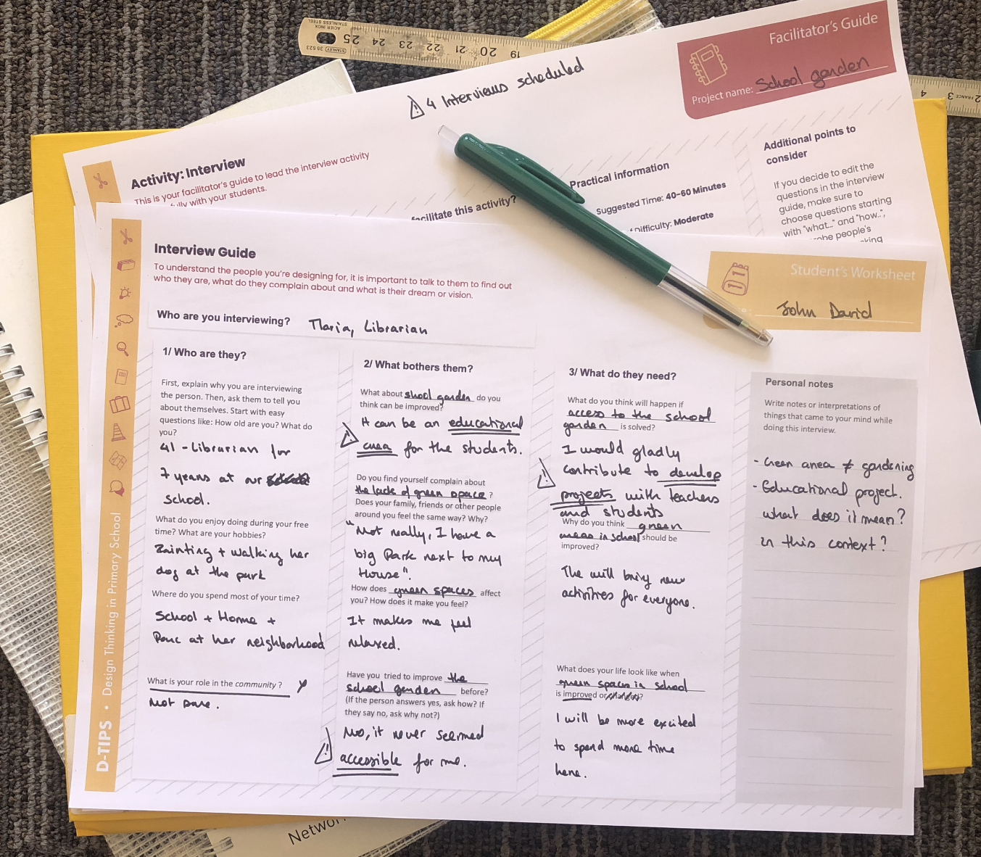
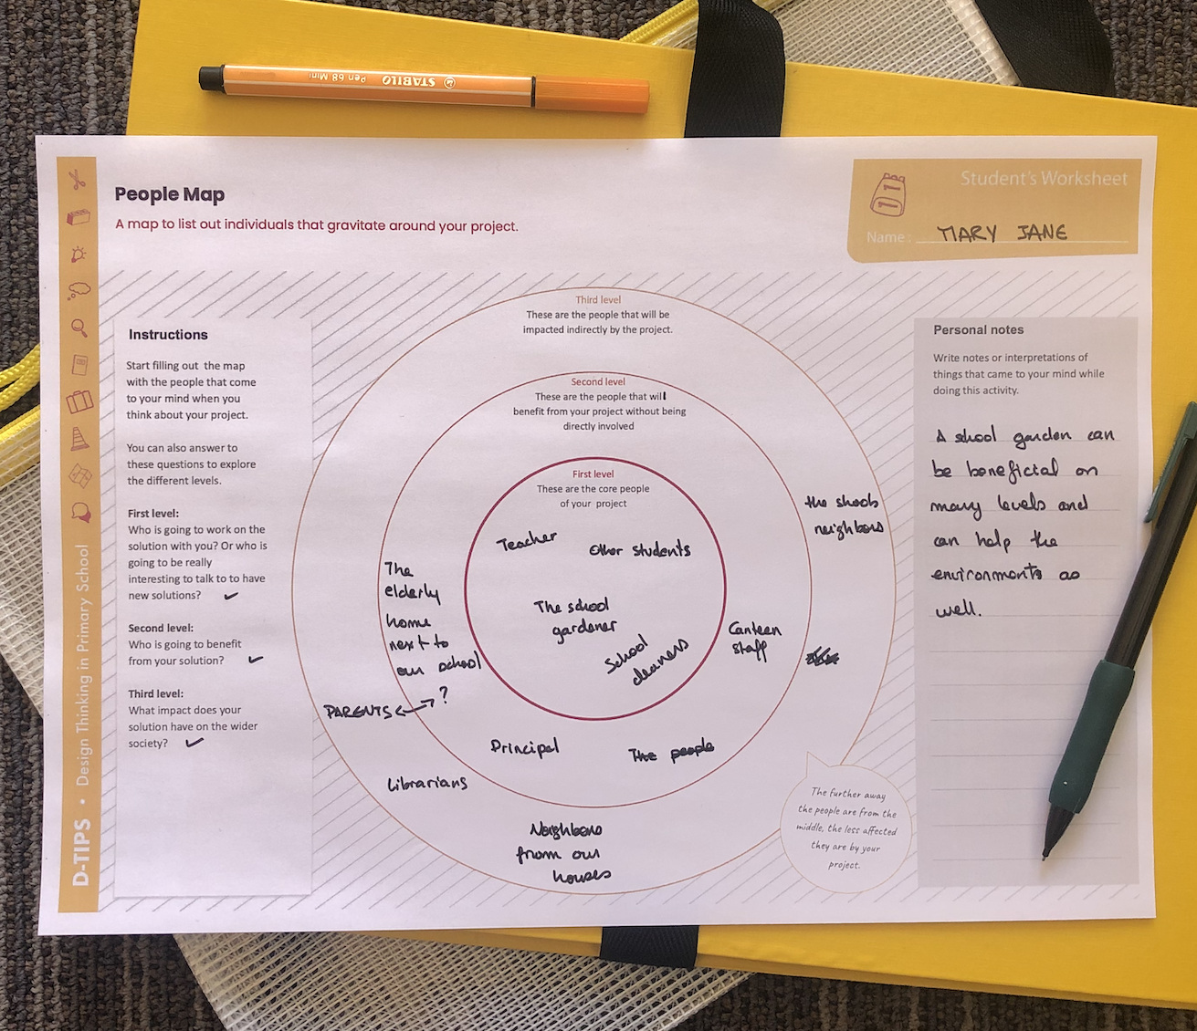
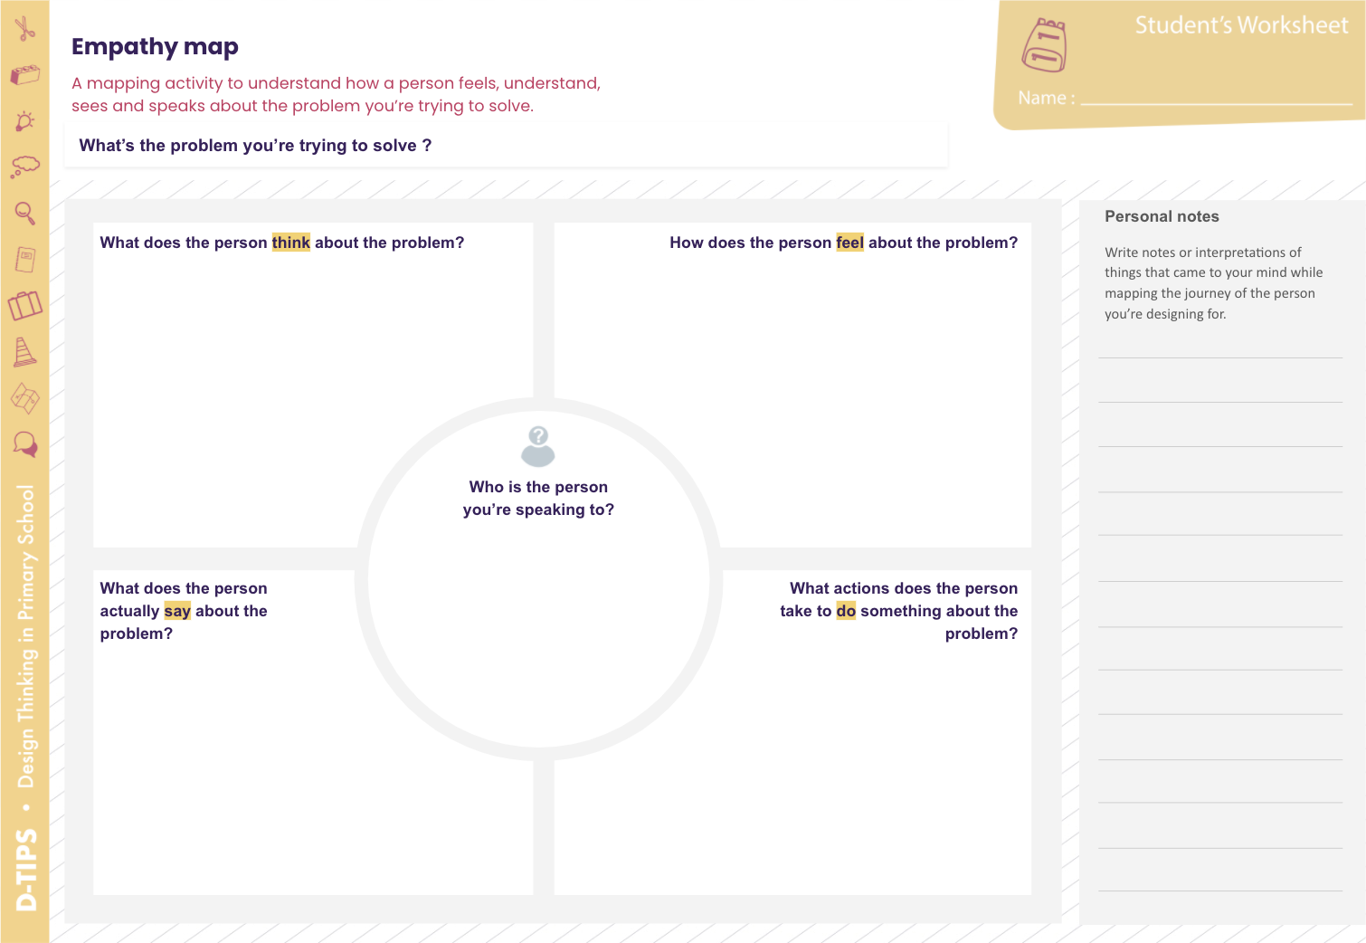
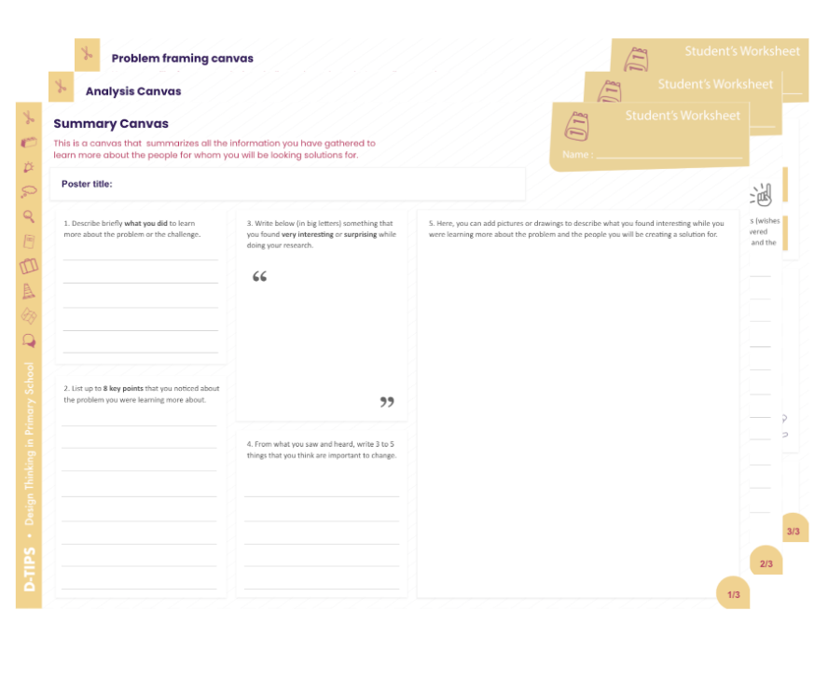
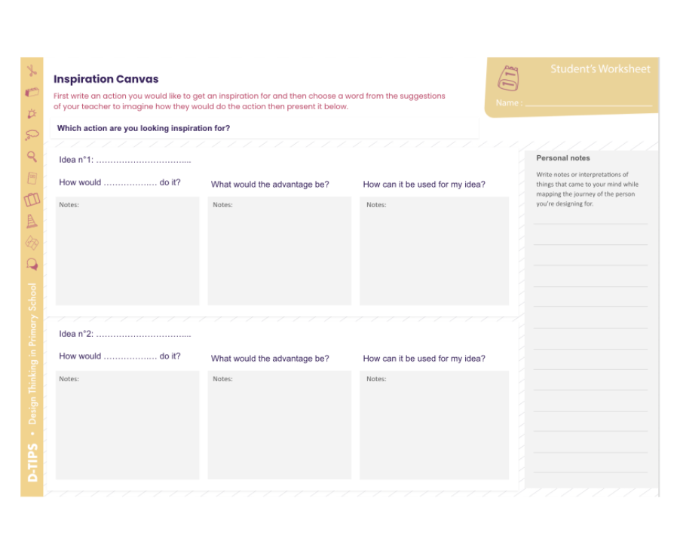
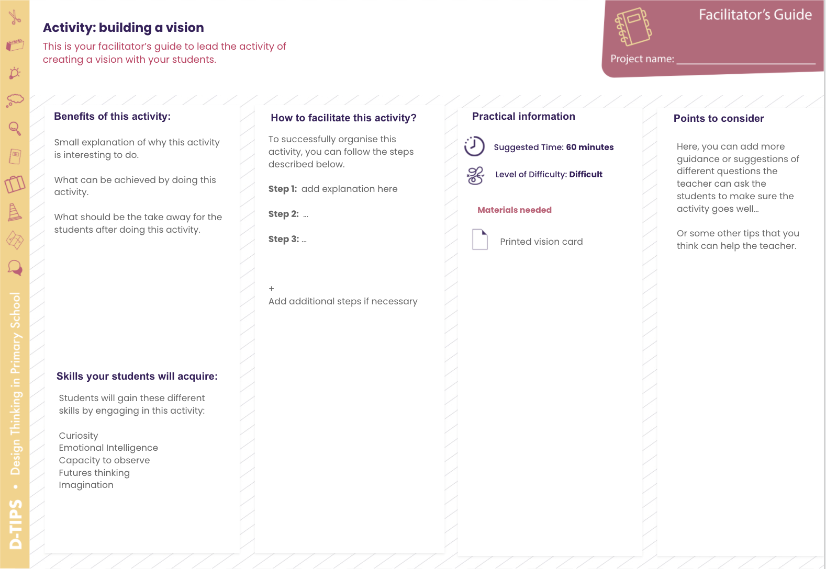
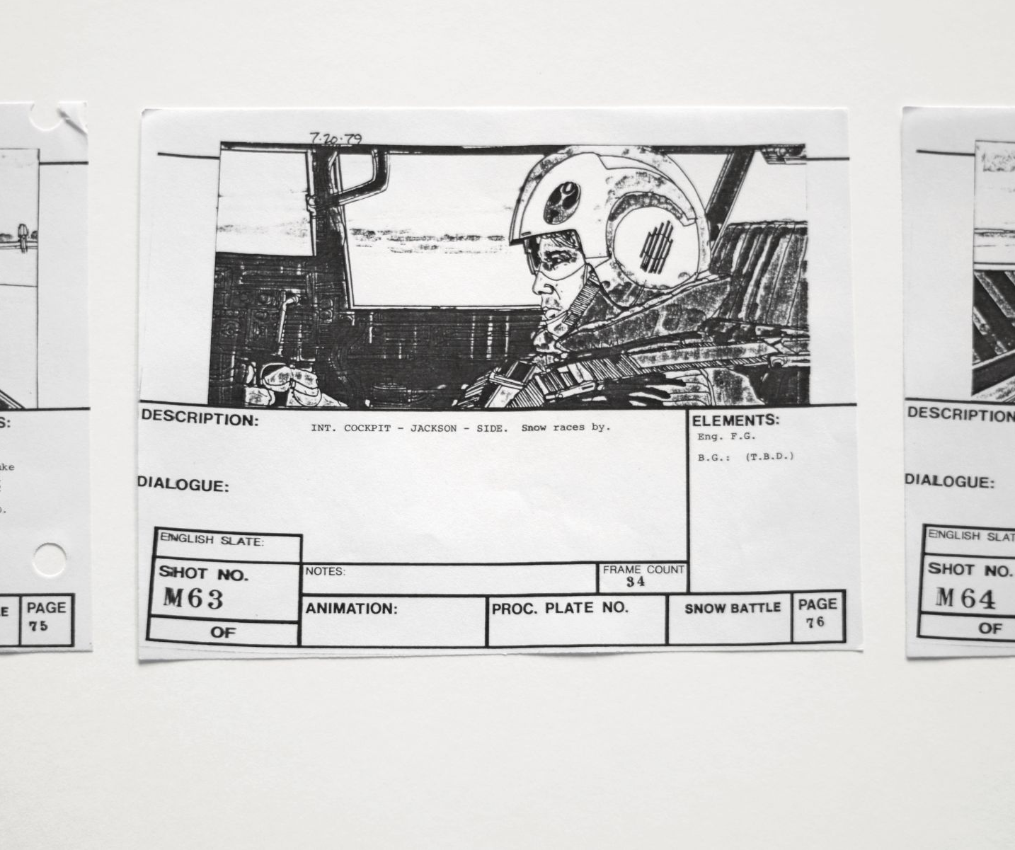
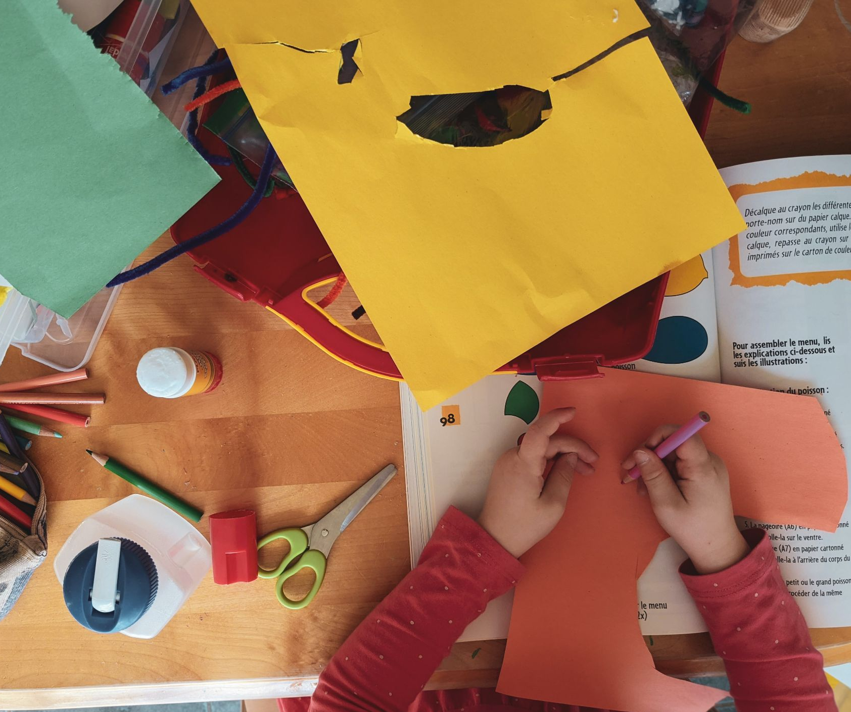
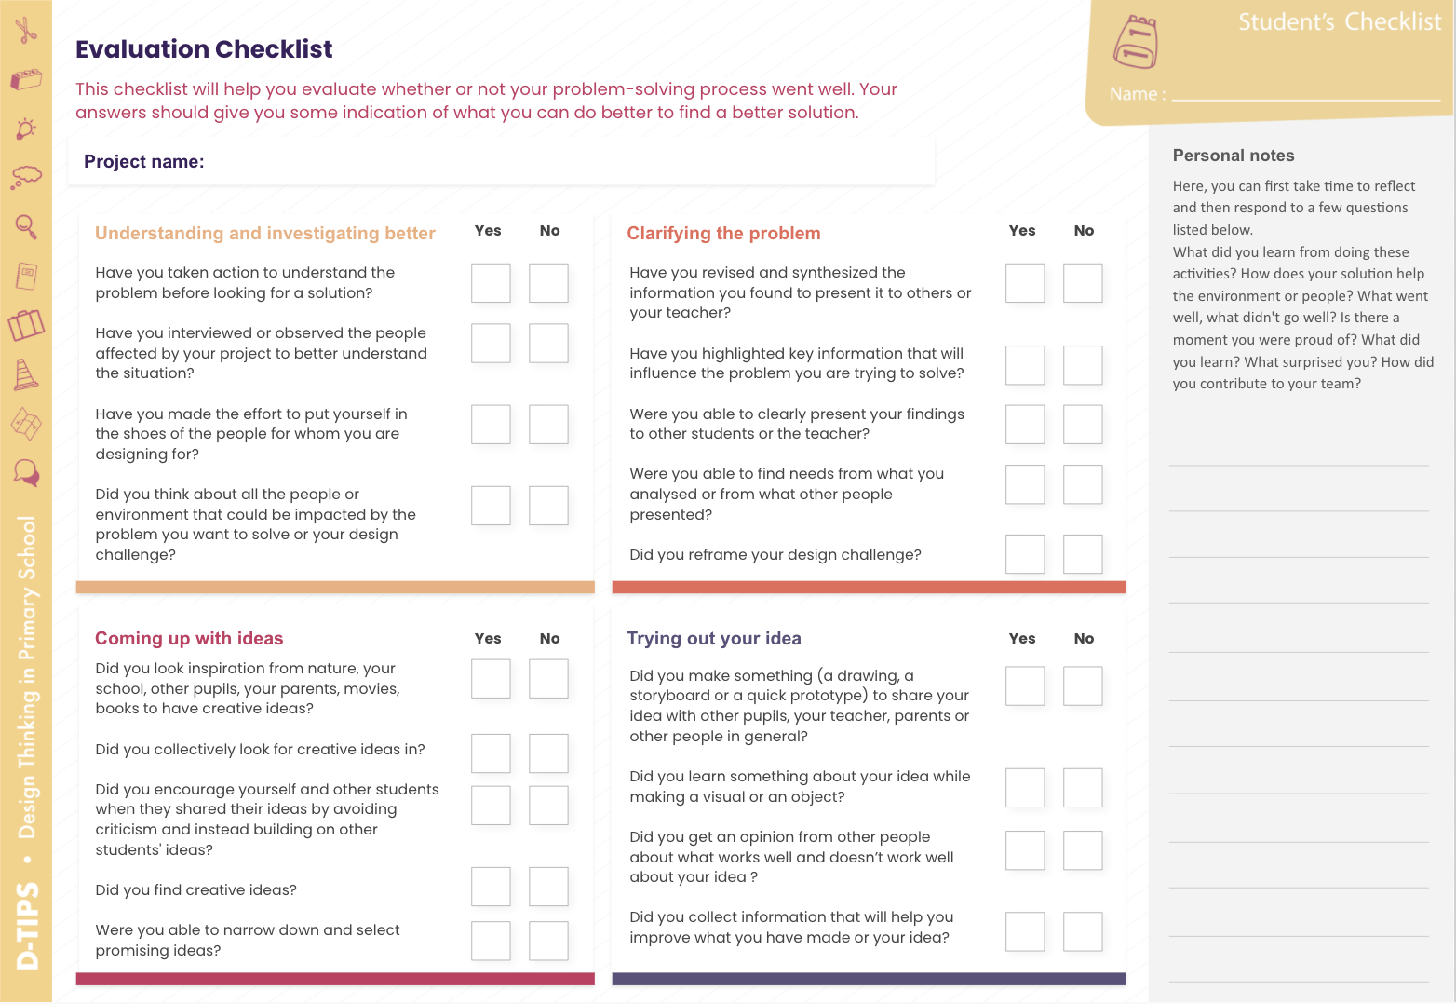
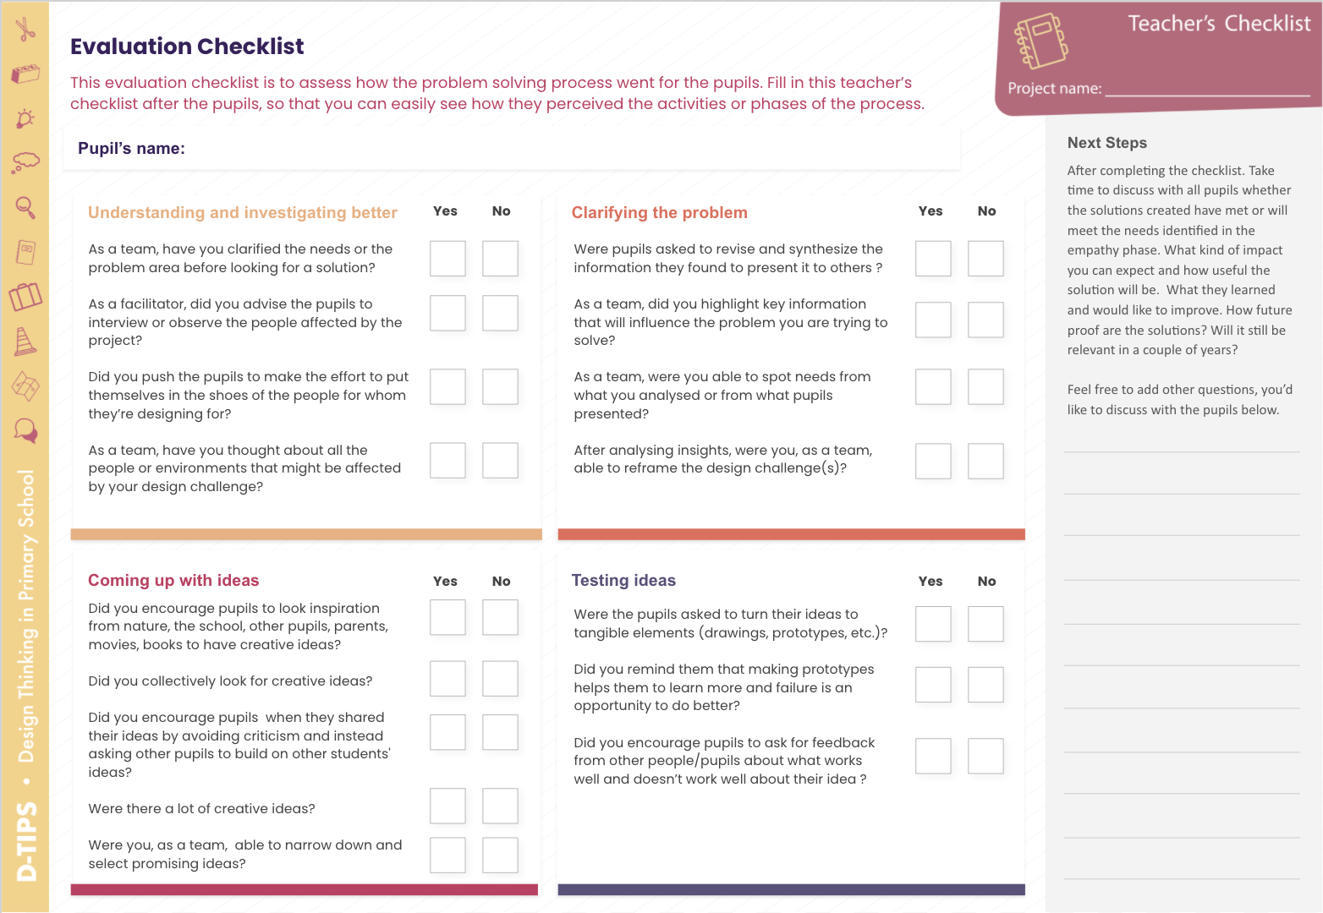
D-TIPS Tools
Below are all the tools you can use with your students.
< Empathize
Interview Guide
People Map
Journey Map
Empathy Map
< Define
Reframe
Inspiration Canvas
Brainstorming
Vision Card
Ideate >
< Test
You’ll find 11 tools displayed here in the Toolbox. All tools have a student’s worksheet (except for Brainstorming and quick prototype) and a facilitator’s guide.
Storyboard
Quick Prototype
Evaluate >
Evaluation Checklist

Slide 19
Hello!
This is your project journey
It will serve you as a notebook and a guiding tool in your journey of putting the design thinking methodology into practice.
There will be questions to help you check if you are on the right track and others to reflect if you are adopting the designer's mindset when working with your students.
The summary that you’ll write after each phase will allow us to create a poster of your project at the end of the project. Make sure to put visuals (images, drawings, sketches) to communicate the project better.

Slide 20
SECTION 1
We are thrilled that you have agreed to participate and we hope you will make the most of it!
You can start by exploring the design challenges (download below) we prepared for you. But, if you wish, you can also come up with your own design challenge to begin your project.
Design Challenges

Slide 21
A short name that clearly communicates your project scope
At the end of this project, I’ll be happy if ….
Write down the design challenge you’ve decided to tackle here
__ / __ / ____

Slide 22
SECTION 2
Great job, you have
completed the essentials.
You can start exploring all the different phases of the design thinking process in order to define how you want to tackle the challenge.
Make sure to take pictures and document the process. We will ask you for some pictures to create a poster of your project.

Slide 23
Empathize
In this phase, it is necessary to meet people you’re designing for (if possible in their own environment) to better understand them and gain insights about their values, needs, thoughts, and motivation.
Add your notes here …
How many opposing views did you have from the people you interviewed/observed?
None
Some
A lot (10 +)
Were you able to form a new understanding of the problem?
Yes
No
Add your notes here …
How have you done things differently than your usual way of doing things? How challenging was that experience?
Add your answer here …
How many times have you gone outside of your usual environment during this activity? Have you gone outside of school? or the classroom?
Add your answer here …

Slide 24
Define
Here, you unpack your findings from the empathize phase into needs and insights and reframe a meaningful design challenge.
Add your notes here …
How many needs and problems did you find after analysing your findings?
< 2
Around 4-7
> 7
Were you able to reframe your challenge after analysing your findings?
Yes
No
Add your notes here …
Were you able to easily let go of the initial challenge to put the needs of the people you’re designing for upfront?
Add your answer here …
Were you able to identify underlying causes of the problem? Closer to the root cause and not a symptomatic problem.
Add your answer here …

Slide 25
Ideate
This phase will help you transition from identifying problems and defining your design challenge to exploring solutions.
Add your notes here …
How many creative ideas were you able to generate?
< 10
Around 10-20
> 20
Were the selected ideas mostly achievable, responsible, actionable and necessary for you?
Yes, absolutely!
Some of them
Not at all
Add your notes here …
How evolved/mature were the initial ideas from the ones selected at the end of the ideation phase?
Add your answer here …
How easy was it for you to lead the session? How were you able to select the ideas that were going to be tested?
Add your answer here …

Slide 26
Test
Testing or experimentation gets ideas and visions out of your head and into the world in visual or tangible ways.
Add your notes here …
How fun and easy to understand was the ideas of the pupils?
It was cool!
They just needed more time …
Just awful!
Were the pupils resourceful enough to copy each others’ ideas?
Yes, absolutely!
Some of them
Not at all
Add your notes here …
How insightful was the process of making their ideas tangible?
Add your answer here …
How many times did you decide to go back to a specific phase to improve the initial idea or design challenge?
Add your answer here …

Slide 27
Evaluate
Evaluating is your chance to debug problems, verify hypotheses and gather feedback to adjust, refine and clarify your ideas.
Add your notes here …
How many questions in the evaluation checklist were you not able to answer?
None
Well I filled it in on the fly, the project is over anyway!
More than 3
Did you identify elements to improve in your solution while doing the evaluation?
Yes!
Not sure
Nothing at all, the solutions were perfect!
Add your notes here …
What have you done after filling out the evaluation checklist with your students?
Add your answer here …
How different is this way of evaluating from your usual way of doing it? Please mention the positive and negative aspects.
Add your answer here …

Slide 28
DO YOU WANT TO ITERATE?
If you wish to repeat a phase or two to debug a problem, clarify some elements, you can duplicate the slides of the corresponding phase and fill it in.

Slide 29
FINISHED?
Fantastic!
Based on the information that you provided so far, we will prepare a poster of your project that you will be able to display. We will share it with you in our next interview session.

Slide 30
ADDITIONAL MATERIAL
In case you want to delve deeper.
You can consult the introduction to the project D-TIPS and the Design Thinking approach as well as the final report of the Gap and Needs of Primary School Teachers research we conducted in early 2020.
Testimonials
Article: staying in the problem space – available only in English
Addressing the Gaps & Needs of Primary School Teachers when Designing the D-TIPS Toolbox - available only in English
Our website

